Slide 1

Capstone Project-1
HOUSE SALE DATA ANALYSIS
Presented by :
Sudhanshi
Shruti Sharma
Siya Bansal
Sneha Jindal

Slide 2

CONTENT
Problem Statement
Objective
Tools Used
Data Summary
Exploratory Data Analysis
Challenges
project summary
Conclusions

Slide 3

PROBLEM STATEMENT
It is our job to predict the sales price for each house. For each Id in the test set,we have predict the value of the SalePrice variable.

Slide 4


Slide 5

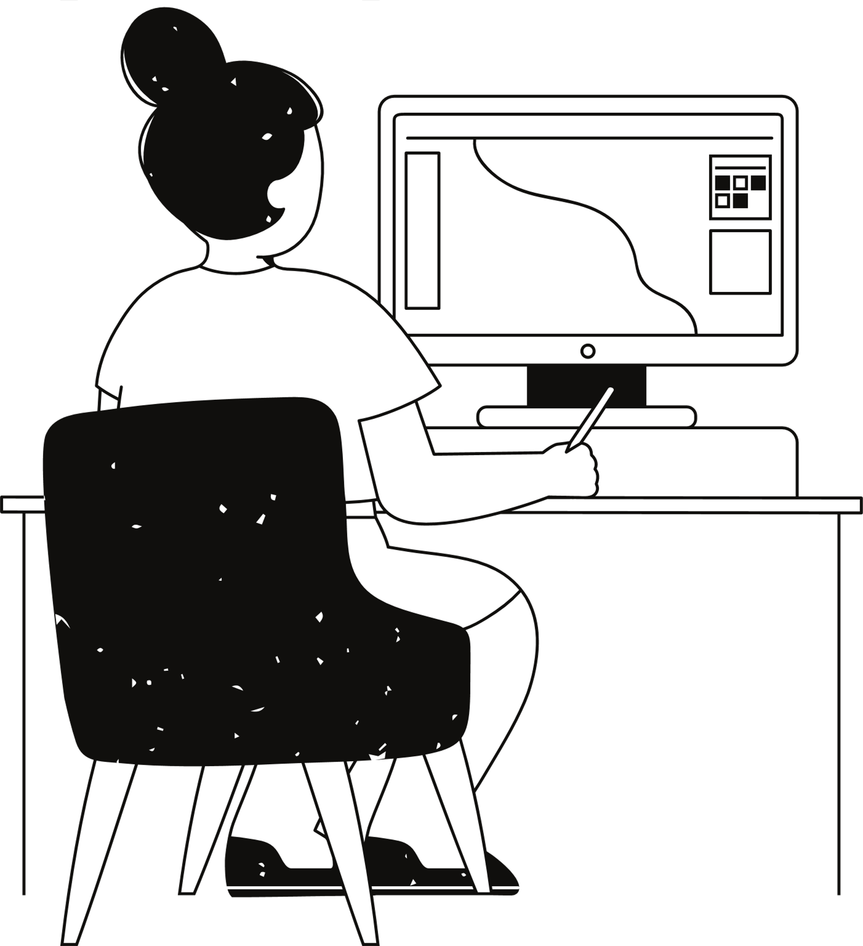
OBJECTIVE
The project's goal is to develop a predictive model that, using different traits or variables from the dataset, can reliably anticipate the sale price of homes.

Slide 6
TOOLS USED
Colab Notebook is used as IDE.
Pandas and NumPy are used for Data Manipulation & Pre-processing and Mathematical functions respectively.
For visualization of the plots, Matplotlib, Seaborn, Plotly are used.
GitHub is used as version control system.

Slide 7
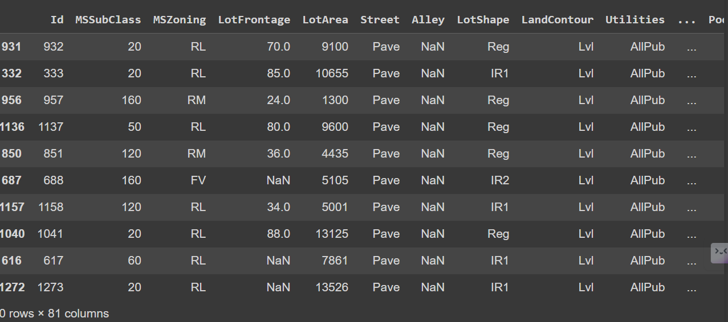
DATA SUMMARY
take a look at our sample data consisting 81 columns.

Slide 8
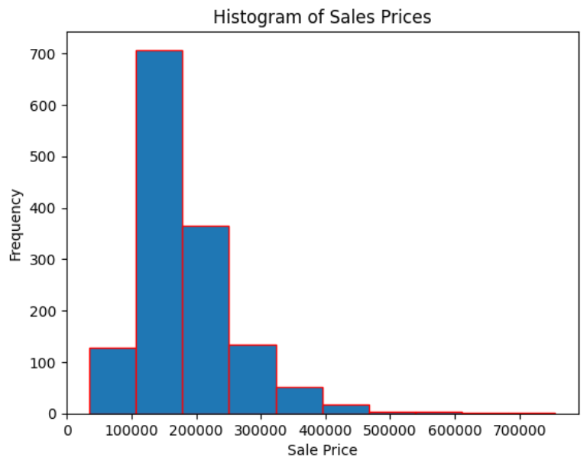
CHART 1
Data Vizualization, Storytelling & Experimenting with charts : Understand the relationships between variables
This histogram provides an overview of the distribution of sale prices in our dataset, helping us to understand the central tendency and spread of the prices.

Slide 9
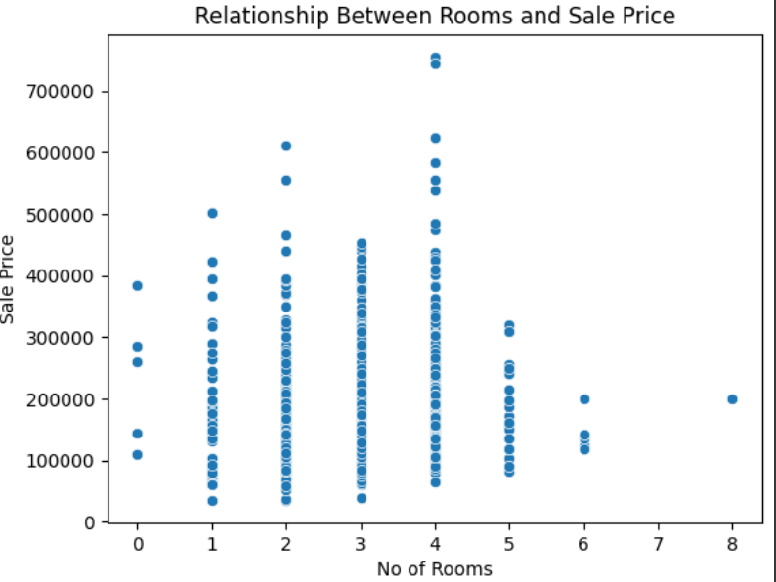
CHART 2
this represent relationship between room and sale prize
This scatter plot can help us to understand if there's any correlation between the number of bedrooms and the sale prices in dataset.

Slide 10
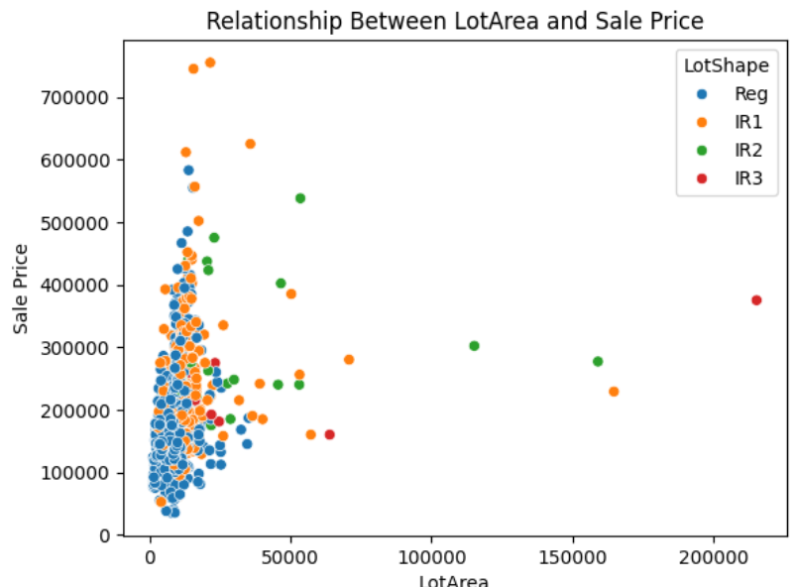
CHART 3
relationship between lot area and sale prize
This scatter plot allows you to explore how the 'LotArea' relates to 'SalePrice', and the hue adds an extra dimension by representing different 'LotShape' categories with distinct colors. It's a helpful visualization for understanding patterns and trends in your data.

Slide 11
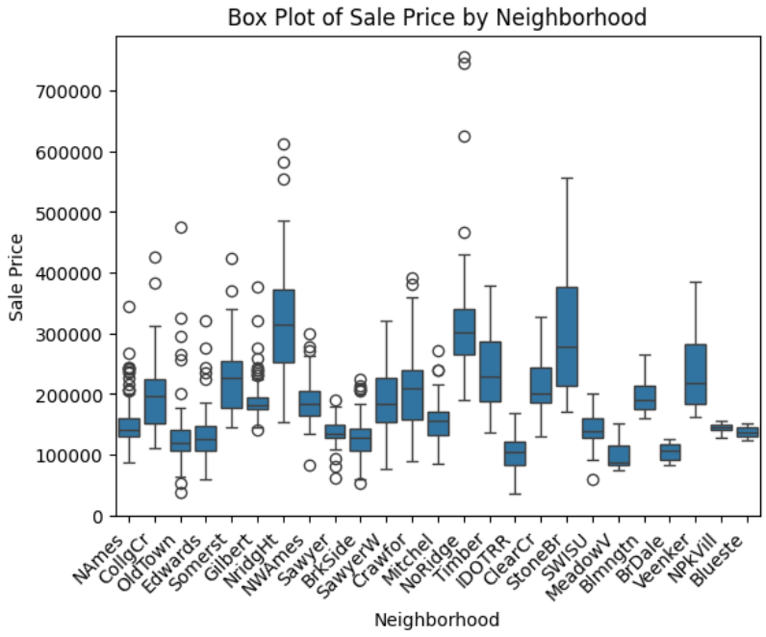
CHART 4
box plot of sale prize by neighbourhood
This box plot helps in understanding the central tendency, spread, and potential outliers in sale prices across different neighborhoods. The box plot provides a visual summary of the distribution of sale prices, allowing for easy comparison between neighborhoods.

Slide 12
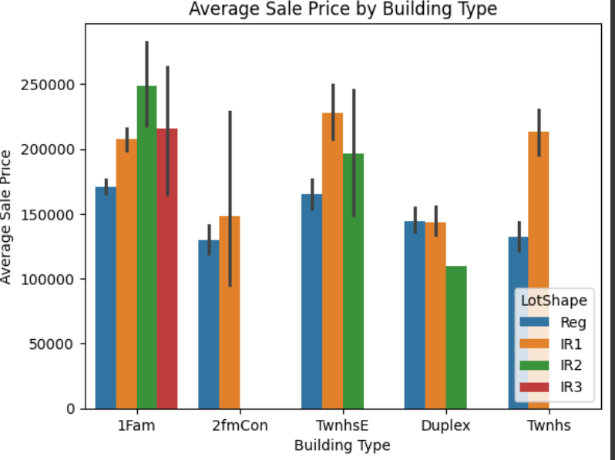
CHART 5
Average sale type by building type
This bar plot allows you to compare the average sale prices across different building types and observe how the distribution of prices varies within each building type based on the lot shape. The color-coded bars provide additional insights into the contribution of different lot shapes to the overall average sale prices for each building type.

Slide 13
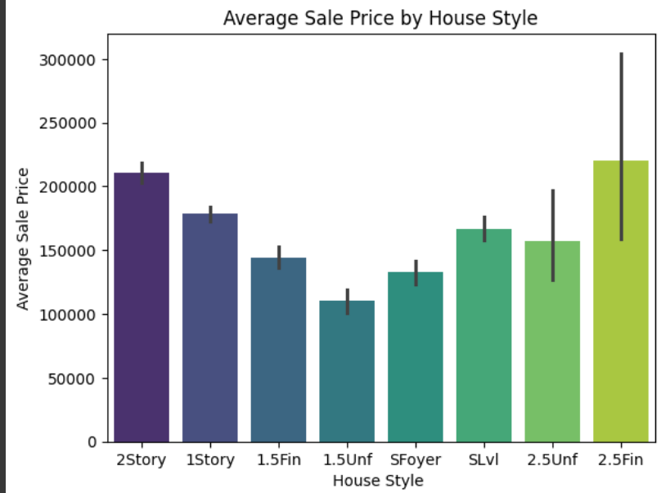
CHART 6
Average sale type by House Style
This bar plot allows you to compare the average sale prices across different house styles, providing insights into how the choice of house style may influence sale prices in your dataset. The color palette enhances the visual appeal of the plot.

Slide 14
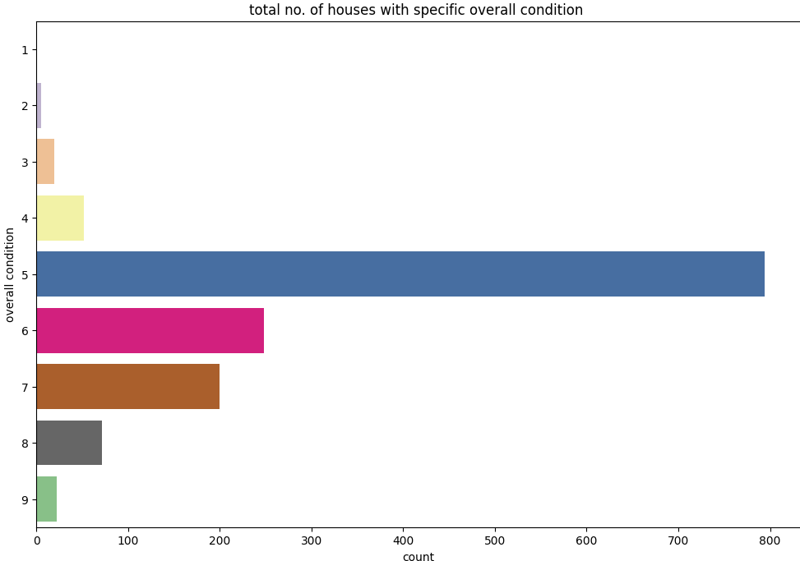
CHART 7
Total number of houses with specific overall condition
It's suitable for visualizing the frequency or count of categorical data, in this case, the overall condition of houses. By setting the 'OverallCond' attribute on the y-axis, each bar in the plot represents the count of houses with a specific overall condition.

Slide 15
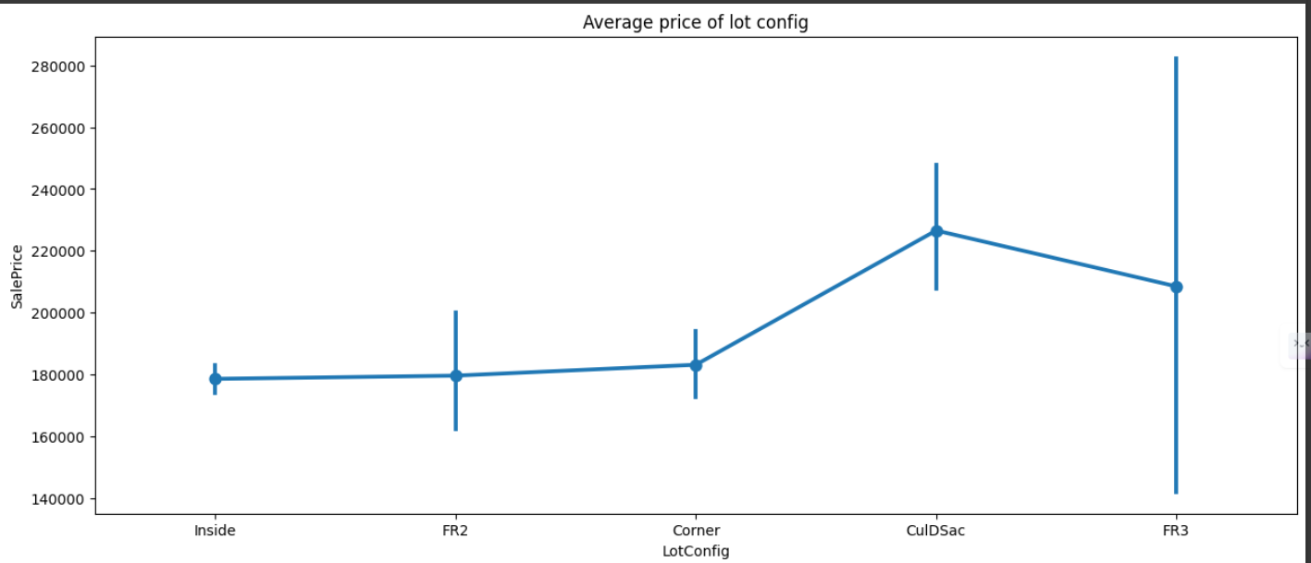
CHART 8
Average prize of lot configuration
A point plot is effective in showing the central tendency (such as mean or median) of a numerical variable across different categories of a categorical variable.

Slide 16
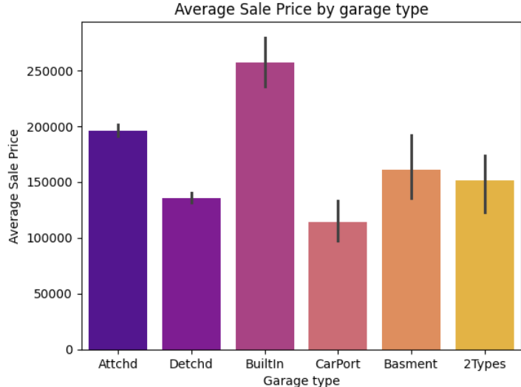
CHART 9
Average sale prize by garbage type
A bar plot is suitable for comparing the average values of a numerical variable across different categories of a categorical variable. In this case, the x-axis represents different garage types, while the y-axis represents the average sale price.

Slide 17
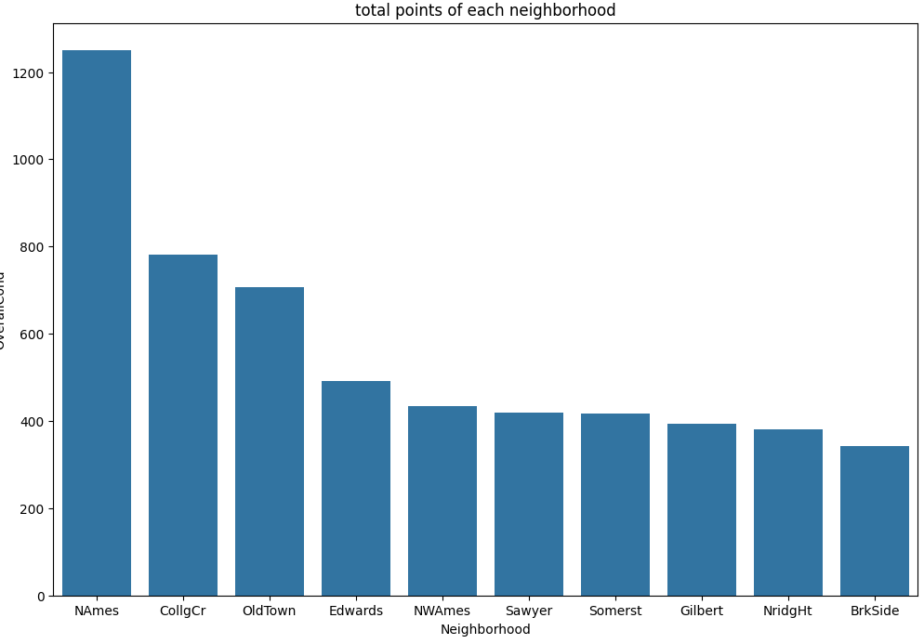
CHART 10
points of each neighbourhood
This plot helps to compare the cumulative overall condition scores across different neighborhoods. By aggregating the overall condition scores for each neighborhood and selecting the top 10 neighborhoods with the highest total points, you can effectively identify which neighborhoods have the highest overall condition ratings.

Slide 18
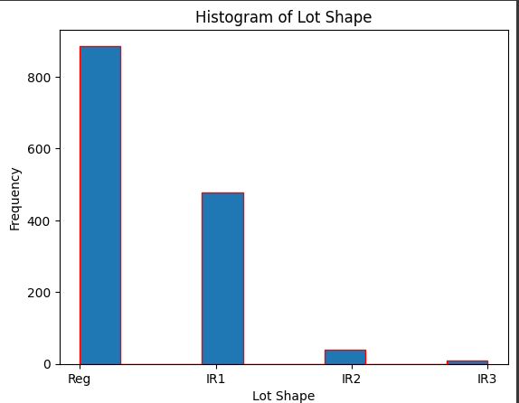
CHART 11
histogram of lot shape
Histograms provide a visual representation of the frequency or count of observations falling within different intervals or bins of the variable's range.

Slide 19
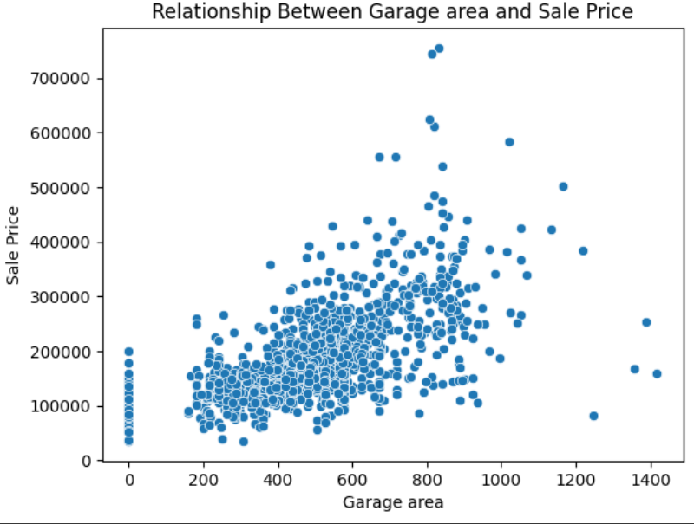
CHART 12
relationship between garagge area and sales price
chosing a scatterplot to depict the relationship between garage area and sales price because it's effective for visualizing the correlation or association between two continuous numerical variables.

Slide 20
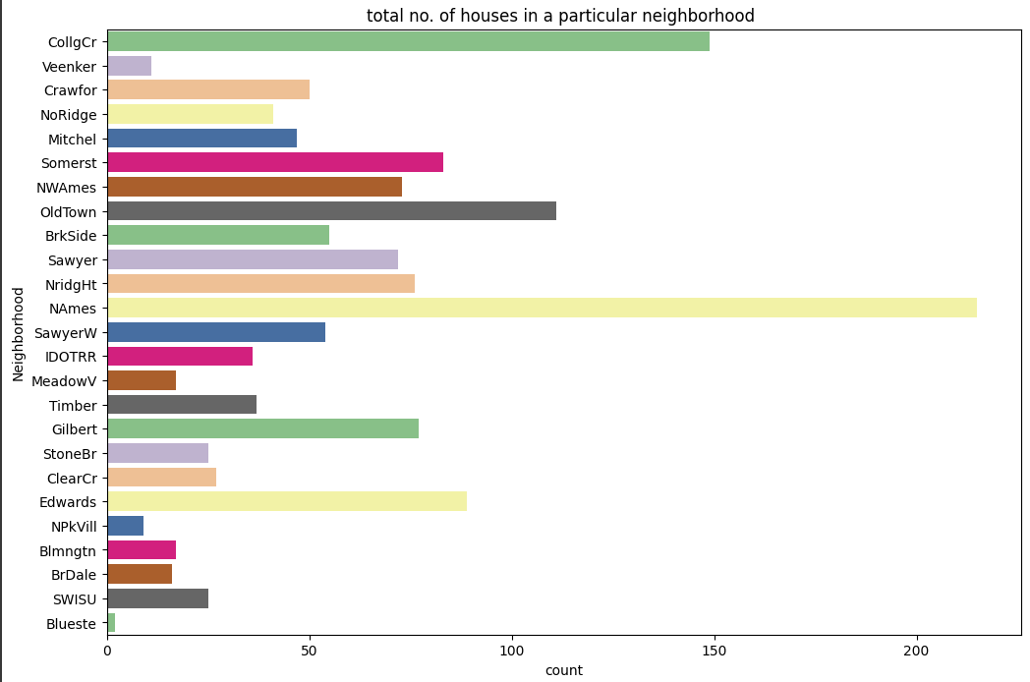
CHART 13
Total number of houses in particular neighbourhood
. In this case, each bar in the plot represents the number of houses in a particular neighborhood. Countplots make it easy to compare the number of houses across different neighborhoods.

Slide 21
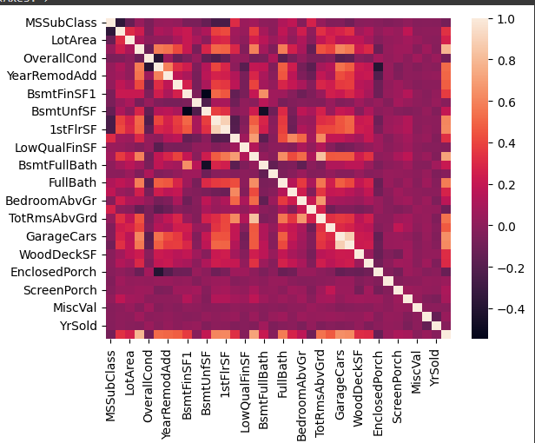
CHART 14
CORRELATION PLOT
a correlation heatmap is used to visualize the correlation between different numerical variables in your dataset.

Slide 22
Challenges
We faced Difficulty to get more insights from such a huge data set.
The columns in the dataset took some time to understand.
We have done some research work to understand the house sale data and it’s prices accordingly to get useful insights .
Lot of rows have NaN or zero as their Minimum price.

Slide 23

PROJECT SUMMARY
In an era defined by technological advancements, our project aims to redefine the real estate landscape by leveraging the capabilities of Artificial Intelligence (AI) and Machine Learning (ML). By meticulously analyzing vast datasets of historical house sale information, we aspire to develop a cutting-edge predictive analytics model. This model is designed not only to forecast property prices accurately but also to identify pivotal market trends, ultimately empowering both buyers and sellers in their decision-making processes.
Project Scope and Approach: To achieve our objectives, we will embark on a comprehensive data collection and cleaning process. Our datasets will encompass a wide array of factors, including location, property size, amenities, and prevailing market conditions. Employing advanced ML algorithms, the model will extract meaningful patterns and correlations from this data, providing the foundation for predicting future property values.

Slide 24
conclusions
In summary, the goal of our project was to apply a predictive model to forecast house sale values. We used a variety of variables from the dataset and conducted thorough analysis and modelling to create a solid prediction framework. The effectiveness of our model was assessed with suitable metrics and verified by comparing it with the test dataset.

Slide 25










Thank you very much!

